Slide 1
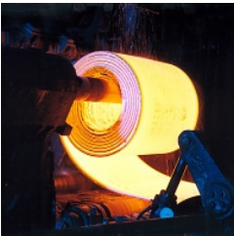
Production Planning at Thyssenkrupp
Group 10:
Abhishu Tailor
Niyati Mudliar
Praveena Venu
Meera Palanivel
Nithin Thomas
Sasi Kumar
Aravind Chintalapudi
Praveen Kumar Singh Jadon

Slide 2
Introduction to the Case Study: Production Planning at thyssenkrupp
Scenario Overview:
The case study delves into the challenges faced by thyssenkrupp Steel Europe, a major European steel company, regarding production planning and performance at its Bochum site in Germany.
The focus is on a pivotal discussion between Markus Schulze, the production manager, and Reinhard Täger, the senior vice president of production operations, regarding significant deviations from planned production figures.
Meeting Background:
The case opens with Schulze receiving a call from Täger, expressing concern over the significant delays in production and the potential impact on delivery performance.
Täger highlights the importance of understanding the root causes behind these deviations and the urgent need for corrective action to ensure timely fulfillment of customer orders.
Historical Analysis:
Täger and Schulze review production data from the past ten years, revealing consistent negative deviations from planned production volumes.
The inability to meet forecasted figures poses challenges not only in meeting customer demand but also in accurate cost calculations and maintaining competitiveness in a competitive steel market.
Challenges and Objectives:
Schulze and Täger recognize the need for a comprehensive analysis to identify the underlying factors contributing to production deviations.
The primary objective is to develop more accurate planning figures to enhance delivery time performance and optimize production efficiency.
Data Analysis and Planning:
Schulze outlines the plan to conduct a detailed analysis of historical data, including aggregating and clustering data to identify key drivers of production variations.
The goal is to develop a predictive model that can anticipate deviations and inform future planning decisions, particularly ahead of the upcoming planning meeting for May production.
Significance of the Case Study:
The case study underscores the critical importance of effective production planning and performance management in the steel industry.
It highlights the challenges faced by manufacturing companies in balancing production targets with customer demands and the implications for overall business success.

Slide 3
Background Information:
1. thyssenkrupp Steel Europe:
Formed in 1999 through a merger between historic German steelmakers Thyssen and Krupp.
Annual production capacity of up to 12 million metric tons of steel with 27,600 employees.
Significant contributor to the parent company thyssenkrupp AG's sales, emphasizing customer orientation, product quality, and delivery time reliability.
2. Bochum Production Lines:
Bochum site receives interim products from steel mills in Duisburg, 40 kilometers away, primarily slabs transported by train.
Bochum's main production line includes a push pickling line (PPL), designed for removing mill scale from hot strip steel.
PPL utilizes a batching process, pushing each strip individually through pickling containers filled with hot hydrochloric acid to remove scale.
Products include pickled hot strip, mainly sold to B2B customers, particularly in the automotive industry.
3. Other Pickling Lines:
Continuous pickling lines operated differently, utilizing continuous processing without the batching method of PPLs.
Decision to invest in a PPL in 2000 due to increasing demand for high-strength steel, which couldn't be processed in continuous lines.
4. Material and Grades:
Products processed on PPL are not simple commodities but a portfolio of different steel grades with specific mechanical properties.
Includes high-strength steel grades, requiring a different pickling process due to rapid cooling after hot rolling.
5. Performance Indicators:
Managers regularly report on production line performance, with throughput (tons produced) and run time ratio (RTR) being crucial metrics.
RTR indicates the portion of time used for production compared to total operating time, influencing capacity planning and delivery performance.

Slide 4
Deviation from Planned Throughput:
Possible Outcomes:
Three potential outcomes exist regarding planned throughput: meeting, exceeding, or falling short of planned production volumes.
If planned throughput is met, excess capacity may remain, leading to inefficiencies and increased costs.
Falling short of planned throughput results in unfulfilled orders, increased costs, and potentially negative impacts on delivery performance.
Historical Deviations:
Analysis of production data from the past ten years reveals consistent deviations from planned production volumes.
Deviations range from significant deficits to occasional overages, highlighting challenges in accurately forecasting and meeting production targets.
Impact on Costs and Performance:
Failure to meet planned throughput results in increased production costs, as fixed costs remain constant while variable costs rise.
Inaccurate cost calculations affect pricing strategies and contribute to lower contribution margins than expected.
Delivery performance is adversely affected, leading to unfulfilled orders and potential customer dissatisfaction.
Common Explanations:
Major breakdowns in production equipment are often cited as a common explanation for deviations from planned throughput.
The run time ratio (RTR) theory suggests that lower RTRs lead to higher negative deviations, indicating the influence of downtime on production efficiency.

Slide 5
Data and Analysis:
Dataset Overview:
The dataset comprises various variables collected over a specified period, including shift details, throughput, dimensions of strips, steel grades, and run time ratio (RTR).
Variables are collected to analyze the factors influencing deviations from planned throughput and identify patterns in production performance.
Data Collection Approach:
Markus Schulze, the production manager, compiles and reviews past production data from October 1, 2013, to April 4, 2014.
Data is aggregated and clustered to identify relationships and patterns among different variables, such as strip dimensions, steel grades, and production shifts.
Analysis Methodology:
Schulze employs statistical analysis techniques to explore correlations and trends within the dataset.
Aggregated data is used to develop predictive models for estimating deviations from planned throughput based on key factors identified during analysis.
Key Objectives:
The primary objective of the analysis is to identify the root causes of deviations from planned production volumes.
Schulze aims to develop a predictive model that can anticipate deviations and inform future production planning decisions.
Importance of Forecasting:
Forecast figures for May production are crucial for predictive modeling and informing planning decisions.
Schulze emphasizes the need for accurate data and timely analysis to develop reliable forecasts and optimize production efficiency.

Slide 6
Assignment Questions

Slide 7
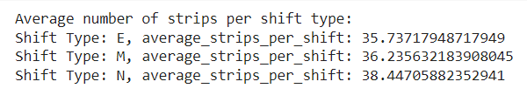
1.What is the average number of strips per shift?

Slide 8
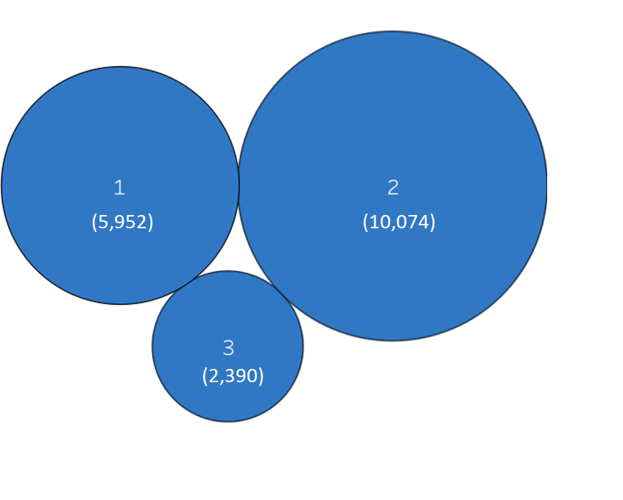
2. Strips of which thickness cluster are the most common, and strips of which thickness cluster are the least common?
It is observed that the strips of Thickness Cluster 2 are the most common, while those of Thickness Cluster 3 are the least common.

Slide 9
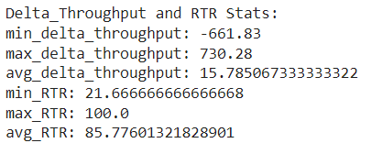
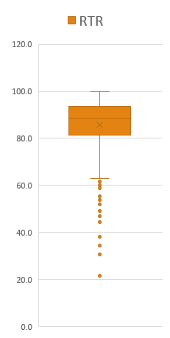
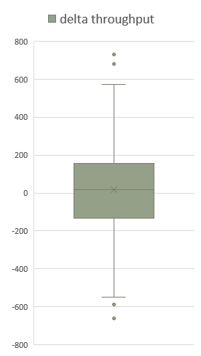
3. What are the min, max, and average values of delta throughput and RTR?
Min | -661.83
Q1 | -132.845
Median | 16.88
Q3 | 157.3725
Max | 730.28
Avg | 15.7850673
Min | 21.6666667
Q1 | 81.25
Median | 88.5416667
Q3 | 93.5416667
Max | 100
Avg | 85.7760132

Slide 10
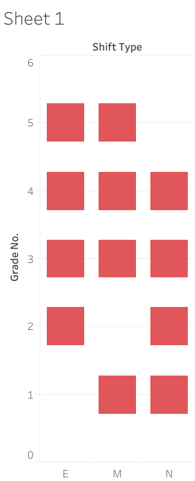
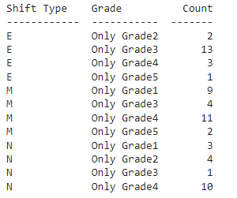
4. Are there shifts during which the PPL processes strips of only steel grade 1, or of only steel grade 2, etc.?
Strips of Grade 1 were processed only in the midday and night shifts.
Strips of Grade 2 were processed only in the early morning and night shifts.
Strips of Grade 5 were processed only in the early morning and midday shifts.
Shift Type

Slide 11
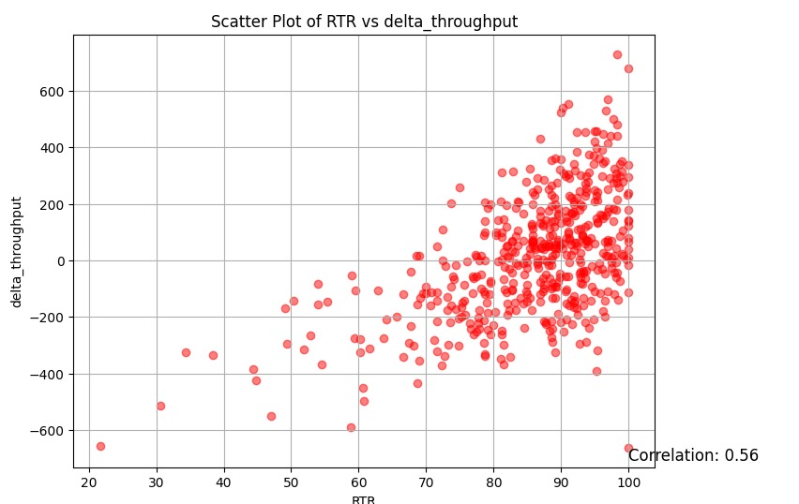
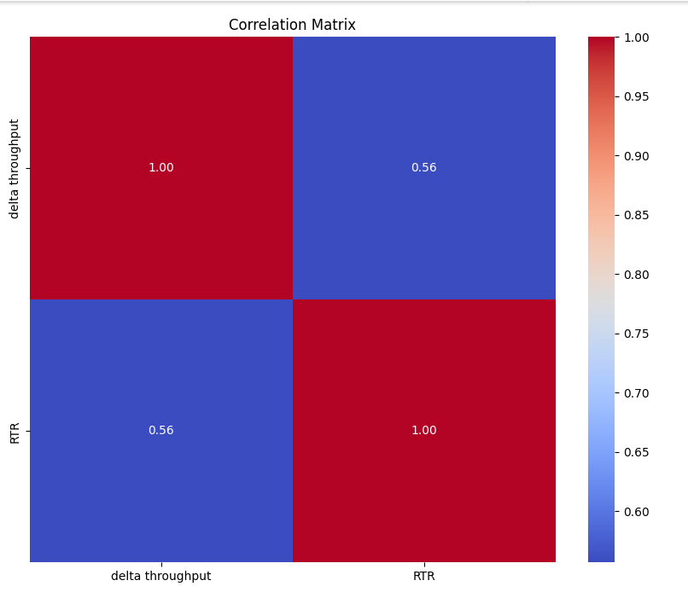
5. Can the RTR theory adequately explain the deviations from the planned production figures?
Simple Linear Regression model to check whether RTR had any impact on the deviations i.e. delta throughput

Slide 12
5. Can the RTR theory adequately explain the deviations from the planned production figures?
Statistical Output:
SUMMARY OUTPUT
Regression Statistics
Multiple R | 0.556843693
R Square | 0.310074898
Adjusted R Square | 0.308689506
Standard Error | 178.249599
Observations | 500
ANOVA
 | df |  | SS | MS | F | Significance F
Regression | 1 |  | 7111334.851 | 7111334.851 | 223.8175 | 4.64673E-42
Residual | 498 |  | 15822913.94 | 31772.91955
Total | 499 |  | 22934248.79
 | Coefficients |  | Standard Error | t Stat | P-value | Lower 95% | Upper 95% | Lower 95.0% | Upper 95.0%
Intercept | -865.4046393 |  | 59.43794712 | -14.55980028 | 2.9E-40 | -982.1846911 | -748.6245875 | -982.1846911 | -748.6245875
RTR | 10.27314833 |  | 0.686683411 | 14.96053081 | 4.65E-42 | 8.92399466 | 11.62230199 | 8.92399466 | 11.62230199

Slide 13
5. Can the RTR theory adequately explain the deviations from the planned production figures?
Inference from Statistical Output:
The correlation coefficient was found to be 0.56.
The p-value is much lesser than 0.05, hence it means that RTR has an impact on delta throughput or deviations. Thus, it also justifies being a KPI to the overall throughput.
Delta throughput (in tons)= −856.4 + 10.273 RTR
The baseline deviation in throughput is −856.4 tons, and for each unit increase in RTR, the deviation in throughput is expected to increase by 10.273 tons.
However, the RSE is found to be 178.25 tons, which means that the actual delta throughput based on RTR theory, even if the model is correct and the true values of regression coefficients are known, any prediction on delta throughput would still vary by 178.25 tons.
The R² = 0.31 very low which means the variability in the delta throughput due to RTR could be explained by nearly 31% only.
In summary, a correlation coefficient of 0.56 indicates a moderate positive linear relationship between the RTR and Delta throughput, suggesting that they tend to move together in the same direction, but it doesn't imply causation.
Thus , RTR theory could not adequately explain the deviations from the planned production figures.

Slide 14
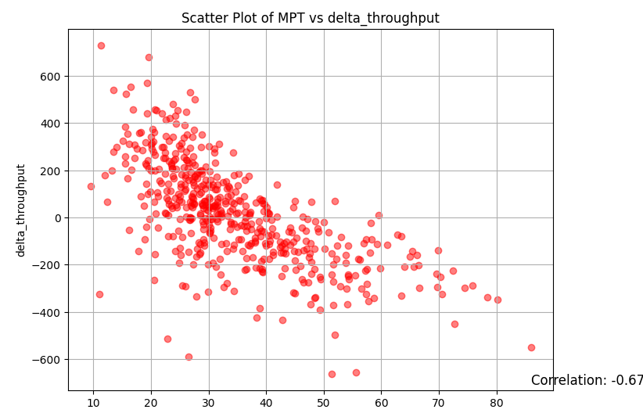
6. Is the MPT theory sufficient to explain the deviations?
In summary, a correlation coefficient of -0.67 indicates a moderately strong negative linear relationship between the two variables, suggesting that they tend to move in opposite directions, but it doesn't imply causation.

Slide 15
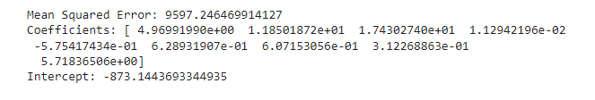

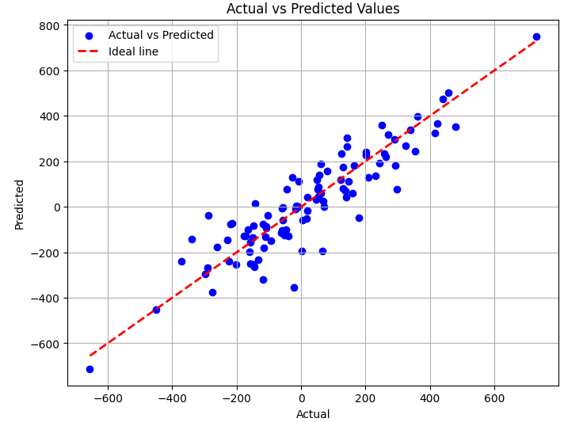
7. Develop a sound regression model that can be used to predict delta throughput based on the characteristics of the strips scheduled for production and Schulze’s estimated RTR
The model has a relatively high R-squared value of 0.8059, indicating that approximately 80.59% of the variance in delta throughput is explained by the independent variables included in the model.
The positive coefficients for some variables (e.g., thickness 1, thickness 2, thickness 3, grade 1, grade 3, grade 4, grade 5, RTR) suggest that increases in these factors tend to lead to higher delta throughput.
Conversely, the negative coefficient for grade 2 (-0.5754) suggests that an increase in grade 2 is associated with a decrease in delta throughput.
The RSE value indicates the level of error in the model's predictions, which could be further optimized through model refinement or additional data analysis techniques.

Slide 16
Conclusion and Recommendations:
Key Findings:
The analysis of production data reveals several factors contributing to deviations from planned throughput, including equipment breakdowns, run time ratio (RTR), and material dimensions.
Historical data highlights challenges in accurately forecasting production volumes and meeting planned targets consistently.
Recommendations:
Implement proactive maintenance strategies to minimize equipment breakdowns and downtime, thereby improving production efficiency.
Refine forecasting models to account for factors such as material dimensions and steel grades, enabling more accurate prediction of throughput.
Optimize capacity utilization by aligning production schedules with demand forecasts and ensuring efficient allocation of resources.
Enhance data collection and analysis capabilities to continuously monitor production performance and identify opportunities for improvement.
Importance of Action:
Addressing the root causes of deviations from planned throughput is critical for improving delivery performance and maintaining competitiveness in the steel market.
Implementing proactive measures based on data-driven insights will enable thyssenkrupp Steel Europe to optimize production efficiency and meet customer demands effectively.

Slide 17
Appendix
Data for analysis
Python Code

Slide 18
Thank you!

